Slide 1
Enterprise-Grade AI Agentic App
On Red Hat OpenShift AI Platform
Model as a Service · Guardrails · RAG · GitOps · Enterprise Architecture
AI Engineering course – class #7 - February 2026
The Hebrew University of Jerusalem
By Yaakov Preiger

Slide 2
AI-Powered ISO Compliance Management
1
2
3
Upload ISO Standards
Populate RAG
Assessment Findings
Upload ISO standard documents
(ISO 9001, 14001, 45001, 13485)
AI extracts clauses
Generates semantic embeddings
Builds knowledge base
Document audit findings
during organization assessment
✓ AI-Generated Compliance Report
Automatic finding-to-clause mapping · Gap analysis · Corrective actions
Hebrew/English bilingual · Export to DOCX/Excel

Slide 3
Architecture layers
Application Layer
iso-web · iso-api · AI Playground · functioonal agents
Model as a Service
GPT-oss-20b (21B MoE) · BGE-M3 Embeddings · Qwen3-4B
AI Governance
TrustyAI · Guardrails Orchestrator · Kuadrant + Authorino
Inference & Serving
KServe · vLLM · LLMInferenceService
Platform
OpenShift 4.20 · OpenShift AI 3.5 · GPU Nodes (NVIDIA L40)

Slide 4
Infrastructure & Resource Management
OpenShift Container Platform
Red Hat OpenShift AI Operator
✓ Namespace Isolation (iso-platform, llm, grafana)
✓ RBAC & ServiceAccounts
✓ Routes (TLS edge termination)
✓ GPU Node Scheduling (L40 48GB VRAM)
✓ StatefulSets (PostgreSQL + pgvector)
✓ ConfigMaps & Secrets Management
✓ Model Serving (KServe, vLLM)
✓ MaaS Gateway (Kuadrant API mgmt)
✓ TrustyAI Service (Observability)
✓ Ray Operator (Distributed ML)
✓ MLflow (Experiment Tracking)
✓ Data Science Pipelines (Tekton)

Slide 5
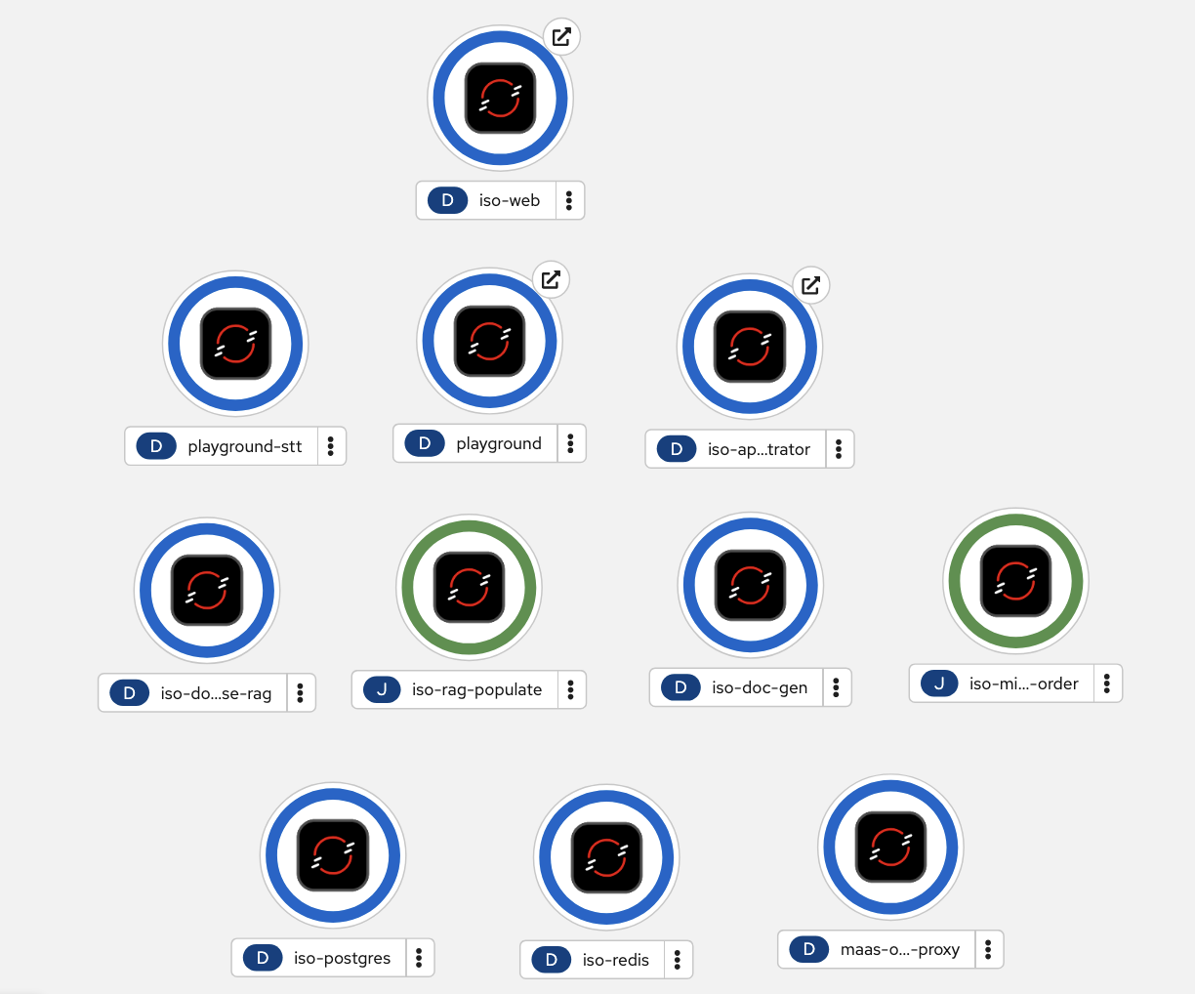
AI Application Stack
React SPA · AI Playground
FastAPI Orchestrator · Document Agents
PostgreSQL 16 + pgvector · Redis
LLM Models (GPT-oss-20b · BGE-M3 · Qwen3)
OpenShift + RHOAI

Slide 6











Enterprise GenAI Inference platform
Model as a Service
AI Gateway/API Mgt
Distributed Inference Framework
Pod 1
Pod 2
Pod 3
Models
Inference Server
External Model Providers
Accelerators
GPU
Instinct
TPU
• GPT-oss-20b
  21B MoE (3.6B active), 128K context.
  Use: Document parsing, reasoning
• BGE-M3
  568M params, 1024-dim embeddings,
  Multilingual EN/HE
  Use: Semantic search, RAG
• GPT-4o
  OpenAI via MaaS proxy, Premium tier
  Use: Complex tasks, fallback

Slide 7
Business case

Slide 8
Observability & Monitoring
Prometheus Metrics
Grafana Dashboards
TrustyAI Audit
• vLLM request rate
• P95/P99 latency
• GPU utilization
• Cache hit rate
• Queue depth
• LLM Observability
• Model health status
• Request tracing
• Resource usage
• SLO tracking
• Request logging
• Bias detection
• Drift analysis
• Fairness metrics
• Compliance reports

Slide 9
GitOps-Driven Deployment
Wave
0-10
Platform Infrastructure
Namespaces · RBAC · Operators
Wave
10-20
Application Infrastructure
PostgreSQL · Redis · Secrets
Wave
20-30
Application Services
iso-api · iso-web · Playground
Wave
40+
Data Population
RAG ingestion · Embeddings
OpenShift GitOps (ArgoCD) · Declarative · Auditable · Auto-sync · Rollback

Slide 10
Enterprise Value Delivered
Production-Ready AI
Operational Excellence
✓ Enterprise security
✓ High availability
✓ Auto-scaling
✓ Disaster recovery
✓ Full observability
✓ GitOps automation
✓ Zero downtime updates
✓ Compliance ready
Developer Productivity
Cost Optimization
✓ OpenAI-compatible API
✓ Multi-model support
✓ Self-service platform
✓ Fast iteration
✓ GPU efficiency
✓ Resource pooling
✓ Usage tracking
✓ On-prem + cloud hybrid

Slide 11
Red Hat OpenShift AI Platform
 | URL
AI Playground | https://playground-iso-platform.apps.ocp.7hrxw.sandbox880.opentlc.com
ISO Compliance App | https://iso-web-iso-platform.apps.ocp.7hrxw.sandbox880.opentlc.com
RHOAI Dashboard | https://rhods-dashboard-redhat-ods-applications.apps.ocp.7hrxw.sandbox880.opentlc.com
Grafana | https://grafana-route-grafana.apps.ocp.7hrxw.sandbox880.opentlc.com
ArgoCD | https://openshift-gitops-server-openshift-gitops.apps.ocp.7hrxw.sandbox880.opentlc.com
MaaS Gateway | https://maas.apps.ocp.7hrxw.sandbox880.opentlc.com

